Slide 1
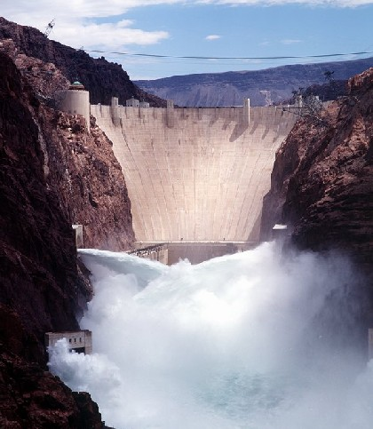
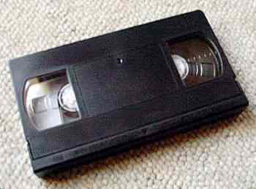
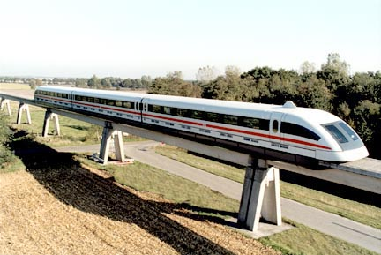
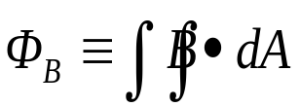
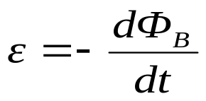
Chapter 34 The Faraday’s Law of Induction
(法拉第电磁感应定律)
dA
B
B

Slide 2
General Review
Electrostatics (静电学)
    motion of “q” in external E-field
    E-field generated by Σq_{i}
Magnetostatics (稳恒磁场)
    motion of “q” and “i” in external B-field
    B-field generated by “i”
Electrodynamics (电动力学)
    time dependent B-field generates E-field
      AC circuits, inductors, transformers, etc.
    time dependent E-field generates B-field
      electromagnetic radiation - light!

Slide 3
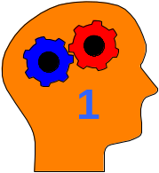
Today...
Induction Effects
Faraday’s Law (Lenz’ Law)
  Energy Conservation with induced currents?
Faraday’s Law in terms of Electric Fields
Cool Applications

Slide 4
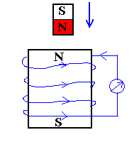
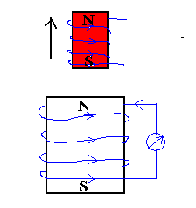
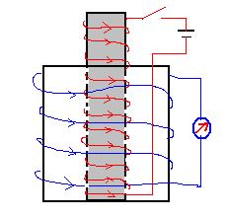
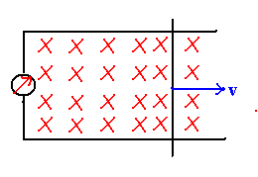
34-1 Basic Phenomena
Φ_{B} change→ε → Induced Current
Induced emf

Slide 5

Induction Effects from Currents
a
Switch closed (or opened)
  ⇒ current induced in coil b
Steady state current in coil a
  ⇒ no current induced in coil b
b
Conclusion:
A current is induced in a loop when:
  • there is a change in magnetic field through it
  • this can happen many different ways
How can we quantify this?

Slide 6
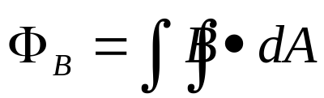
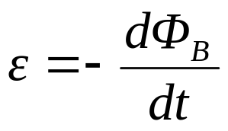

34-2 Faraday's Law of Induction
Define the flux of the magnetic field through an open surface as:
dA
B
B
Faraday's Law:
  The emf ε induced in a circuit is determined by the time rate of change of the magnetic flux through that circuit.
So what is
this emf??
  The minus sign indicates direction of induced current (given by Lenz's Law).

Slide 7
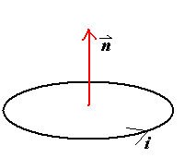
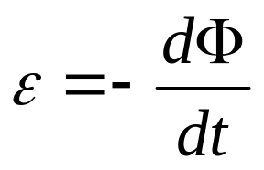
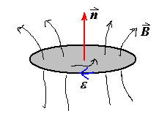
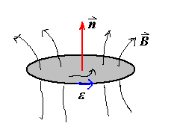
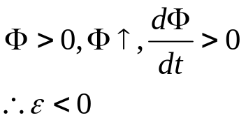
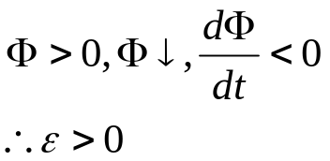
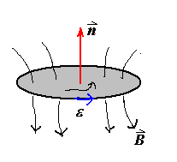
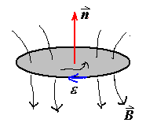
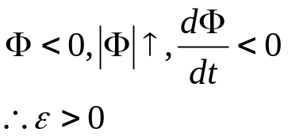
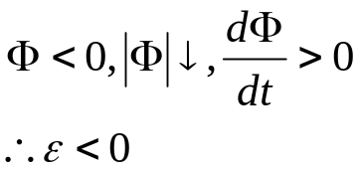
Sign of ε
Right Hand Rule

Slide 8
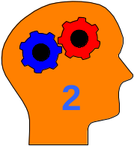
34-3 Lenz‘s Law (楞次定律)
Lenz's Law:
  The induced current will appear in such a direction that it opposes the change in flux that produced it.
B
B
S
N
N
S
v
v
Conservation of energy considerations:
  Claim: Direction of induced current must be so as to oppose the change; otherwise conservation of energy would be violated.
    Why???
      If current reinforced the change, then the change would get bigger and that would in turn induce a larger current which would increase the change, etc..

Slide 9

Application of Induction
E-M Cannon(电磁炮)
v
Connect solenoid to a source of alternating voltage.
~
The flux through the area ⊥ to axis of solenoid therefore changes in time.
side view
A conducting ring placed on top of the solenoid will have a current induced in it opposing this change.
B
F
•
•
B
There will then be a force on the ring since it contains a current which is circulating in the presence of a magnetic field.
•
F
B
top view

Slide 10
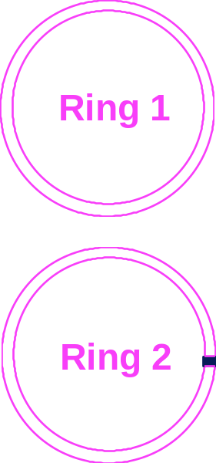
Chapter 34, Act 1
For this act, we will predict the results of variants of the electromagnetic cannon demo which you just observed.
  Suppose two aluminum rings are used in the demo; Ring 2 is identical to Ring 1 except that it has a small slit as shown. Let F₁ be the force on Ring 1; F₂ be the force on Ring 2.
3A
(a) F₂ < F₁
(b) F₂ = F₁
(c) F₂ > F₁
3B
Suppose two identically shaped rings are used in the demo. Ring 1 is made of copper (resistivity = 1.7X10⁻⁸ Ω-m); Ring 2 is made of aluminum (resistivity = 2.8X10⁻⁸ Ω-m). Let F₁ be the force on Ring 1; F₂ be the force on Ring 2.
(a) F₂ < F₁
(b) F₂ = F₁
(c) F₂ > F₁

Slide 11
Chapter 34, Act 1
For this act, we will predict the results of variants of the electromagnetic cannon demo which you just observed.
  Suppose two aluminum rings are used in the demo; Ring 2 is identical to Ring 1 except that it has a small slit as shown. Let F₁ be the force on Ring 1; F₂ be the force on Ring 2.
3A
(a) F₂ < F₁
(b) F₂ = F₁
(c) F₂ > F₁
The key here is to realize exactly how the force on the ring is produced.
A force is exerted on the ring because a current is flowing in the ring and the ring is located in a magnetic field with a component perpendicular to the current.
An emf is induced in Ring 2 equal to that of Ring 1, but NO CURRENT is induced in Ring 2 because of the slit!
Therefore, there is NO force on Ring 2!

Slide 12
Chapter 34 ACT 1
For this act, we will predict the results of variants of the electromagnetic cannon demo which you just observed.
  Suppose two identically shaped rings are used in the demo. Ring 1 is made of copper (resistivity = 1.7X10⁻⁸ Ω-m); Ring 2 is made of aluminum (resistivity = 2.8X10⁻⁸ Ω-m). Let F₁ be the force on Ring 1; F₂ be the force on Ring 2.
3B
(a) F₂ < F₁
(b) F₂ = F₁
(c) F₂ > F₁
The emf’s induced in each case are equal.
The currents induced in the ring are NOT equal because of the different resistivities of the materials.
The copper ring will have a larger current induced (smaller resistance) and therefore will experience a larger force (F proportional to current).

Slide 13
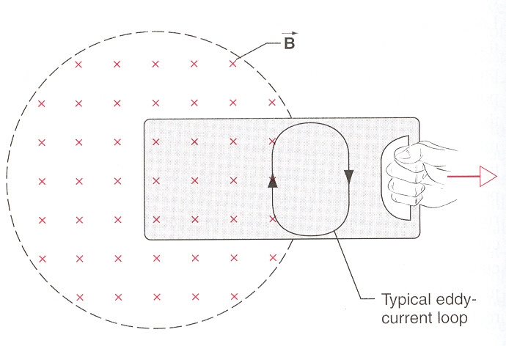
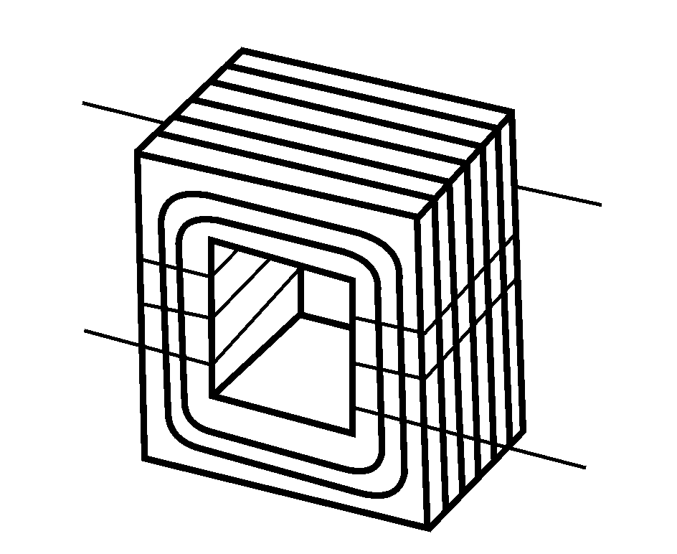
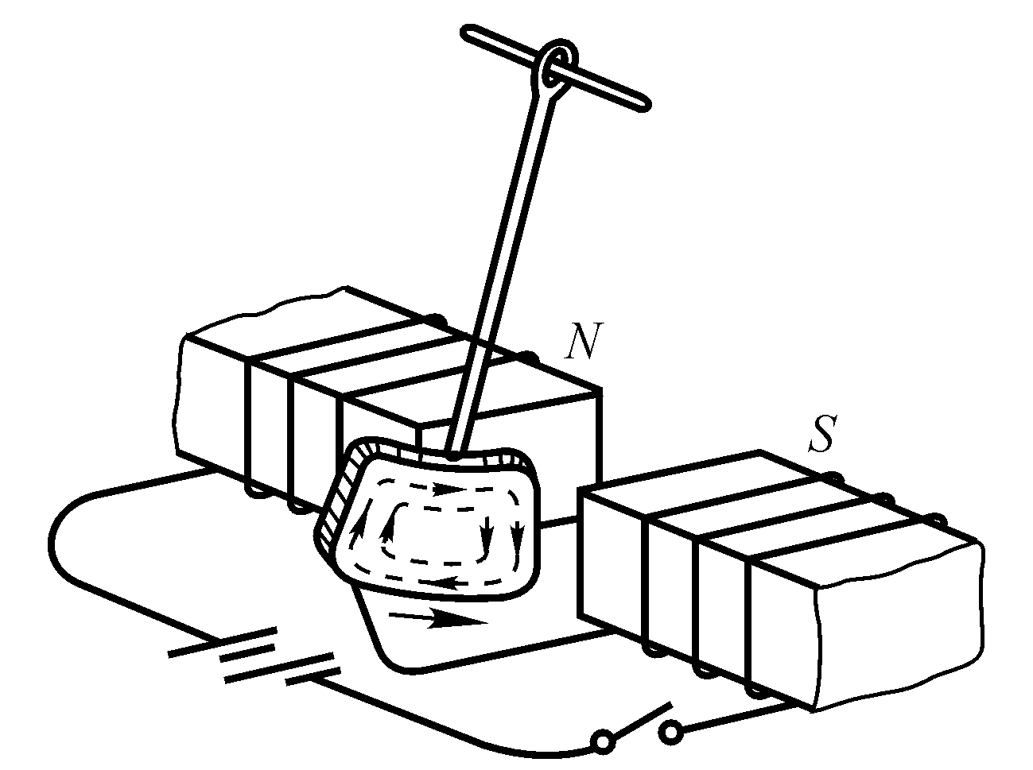
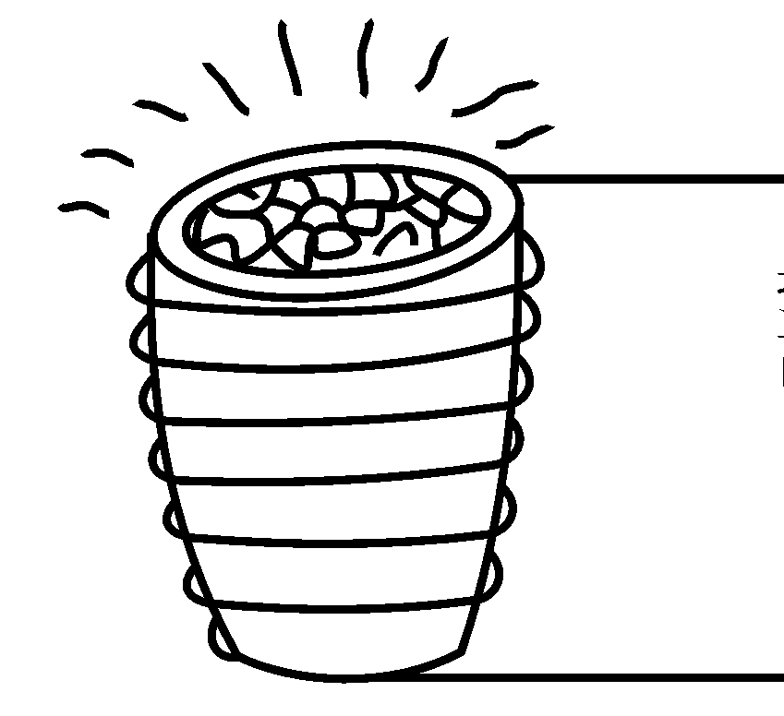
Eddy currents(涡流)
Materials are laminated.
Induction furnace
Magnetic breaking

Slide 14
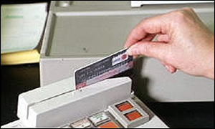
More Applications of Magnetic Induction
Tape / Hard Drive / ZIP Readout
  Tiny coil responds to change in flux as the magnetic domains (encoding 0’s or 1’s) go by.
  Question: How can your VCR display an image while paused?
Credit Card Reader
  Must swipe card
  → generates changing flux
  Faster swipe → bigger signal

Slide 15
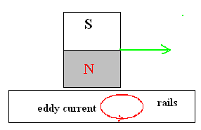
More Applications of Magnetic Induction
Magnetic Levitation (Maglev) Trains
  Induced surface (“eddy”) currents produce field in opposite direction
  → Repels magnet
  → Levitates train
  Maglev trains today can travel up to 520 km/hr
  → Twice the speed of Amtrak’s fastest conventional train!
  May eventually use superconducting loops to produce B-field
    → No power dissipation in resistance of wires!

Slide 16
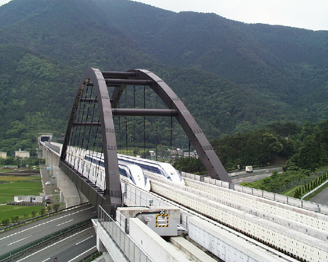
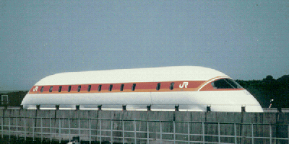
Superconducting MagLev in Japan

Slide 17
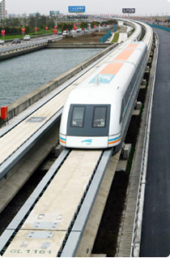

Magnetic Levitation (Maglev)
Trains in Shanghai, 411km/hrs

Slide 18
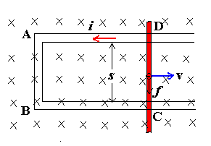
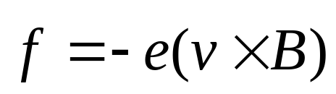
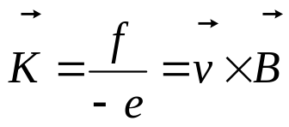
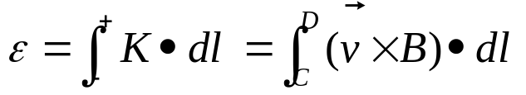
34-4 Motional emf (动生电动势) and
Induced emf (感生电动势)
In a steady magnetic field, moving conductor: motional emf
Conductor in steady, Changing magnetic field: induced emf
Motional emf:
Lorentz force results in a motional emf.
Electron moves in the direction of DCBA
Non electrostatic force:
（非静电力）
Motional emf:

Slide 19
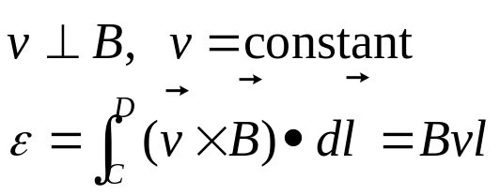
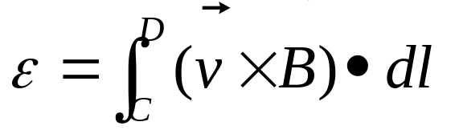
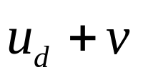
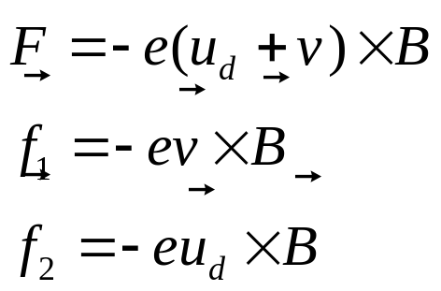
Notes
In high school case:
Motional emf exists only in the moving conductor
For any cases, (any shape, closed, non-closed)
Lorentz force can’t do work to electron! Why we speak that Lorentz force results in a motional emf？ Due to: the velocity of electron
Do positive work
Do negative work

Slide 20
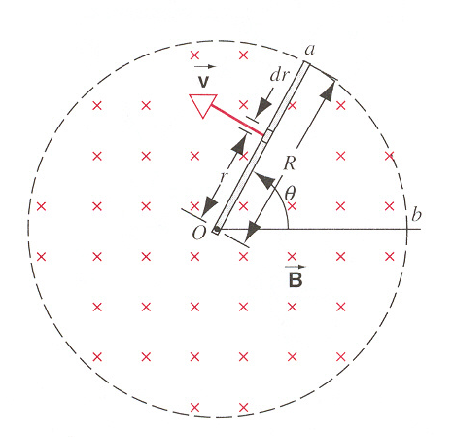
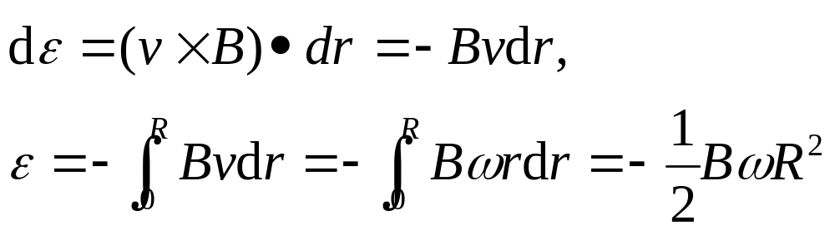
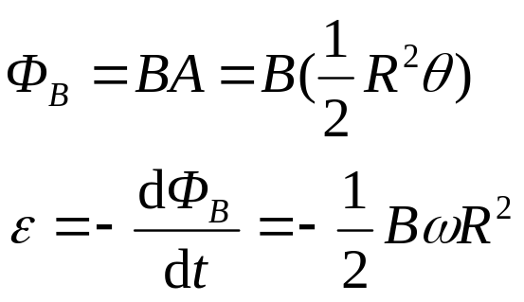
Example: Page 781, Sample problem 34-4
Solution 1:
Solution 2: Suppose oab is a loop,
A copper rod of length R, angular frequency ω, in an uniform magnetic field B
What is the direction of induced emf?
+ o, - a

Slide 21
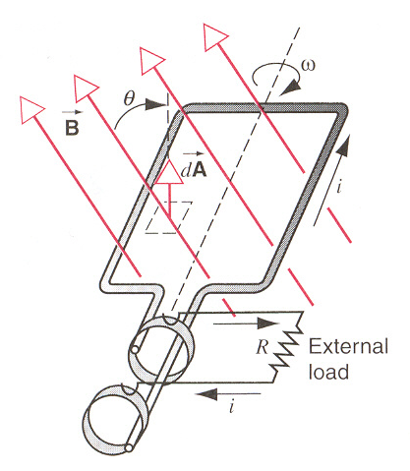
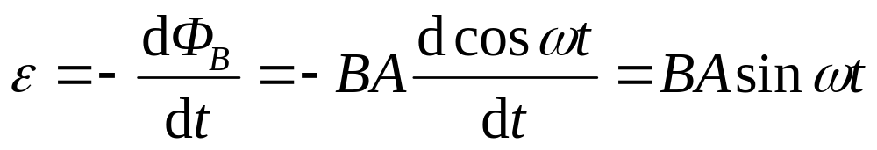
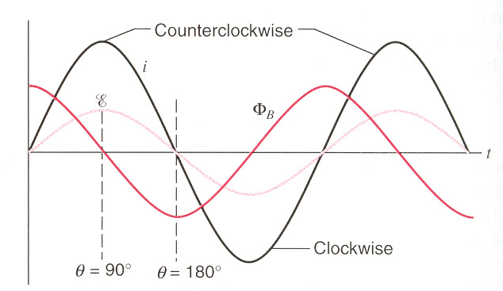
Applications: Generators and Motors
Generator is a device for converting mechanical work (or other) into electrical work in the load.
Alternating current (AC)

Slide 22
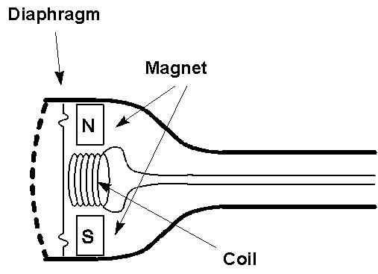
Applications of Magnetic Induction
AC Generator
  Water turns wheel
  → rotates magnet
  → changes flux
  → induces emf
  → drives current
“Dynamic” Microphones
  (E.g., some telephones)
  Sound
  → oscillating pressure waves
  → oscillating [diaphragm + coil]
  → oscillating magnetic flux
  → oscillating induced emf
  → oscillating current in wire
  Question: Do dynamic microphones need a battery?

Slide 23
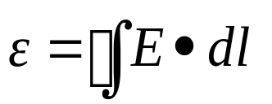
2. Induced emf 感生电动势
(Vortex electric field，涡旋电场)
time
A magnetic field, increasing in time, passes through the blue loop
An electric field is generated “ringing” the increasing magnetic field
Circulating E-field will drive currents, just like a voltage difference
Loop integral of E-field is the “emf”
Note: The loop does not have to be a wire—the emf exists even in vacuum! When we put a wire there, the electrons respond to the emf → current.

Slide 24
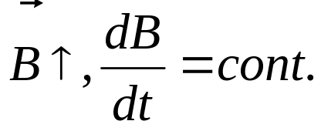


Induced emf (Cont.)
1. Induced electric field E
If there is a circular loop, induced current i, induced emf ε
If there is no circular loop,
induced emf ε
induced electric field E
Notes:
The induced electric field is just real as any that might be set up by static charges, for instance, it exists a force q₀E on a test charge.
The presence of the induced electric field has nothing to do with the presence of the loop of wire.

Slide 25





Induced electric field
The work W done on the charge by the induced electric field E in circular is q₀ε
Faraday’s Law:
For any point in space
It is apparent that Faraday’s Law implies that a changing magnetic field produces an electric field.

Slide 26





Notes
can be applied to any shape paths
E_{s} is set up by charges,
E_{in} is set up by changing magnetic field.
Both kinds of electric field exert on charges.
E_{s}:
E_{in}:
Note: In Ch. 28 we claimed , so we could define a potential independent of path. This holds only for charges at rest (electrostatics). Forces from changing magnetic fields are nonconservative, and no potential can be defined!

Slide 27


Application: The betatron
(电子感应加速器, 电子回旋加速器)
Betatron produces a pulsed rather than a continuous beam.

Slide 28



34-5. Induction & Relative Motion
In the Reference S fixed with B:

Slide 29

Induction & Relative Motion
W_{N}+ W_{i}=0, the work by force F_{B} on the charge carrier is zero. It does not apply energy, but play the role of transforming energy.
Motional emf is intimately connected with the sideways deflecting force by a magnetic field.

Slide 30



Induction & Relative Motion
The Reference S’ fixed with the loop:
Force is of purely electric origin,
In general in S’’:

Slide 31
Induction & Relative Motion
Electric and magnetic fields are not independent of each other. They are in one unity—electromagnetic field.
The basic laws of electromagnetism, including Faraday’s law, hold in all inertial reference frames.
Maxwell’s equations are invariant with respect to the Lorentz transformation.

Slide 32


Summary
Faraday’s Law (Lenz’s Law)
  a changing magnetic flux through a loop induces a current in that loop
negative sign indicates that the induced EMF opposes the change in flux
Faraday’s Law in terms of Electric Fields

Slide 33


Escher depiction of nonconservative emf

Slide 34
Homework
Page 793 (exercises), 26, 33
Page 797, 6, 11, 14

